Slide 1
Newton’s Second Law of Motion
F=ma

Slide 2
Newton’s 3 Laws
First Law: an object at rest tends to stay at rest, and an object in motion tends to stay in motion, with the same direction and speed
Second Law: F = ma
Third Law: for every action (force) there is an equal and opposite reaction (force)

Slide 3
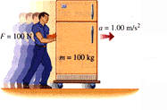
Recap
Uniform Motion - First Law
we know that IF the forces on an object are balanced (ΣF=0) the object will maintain a state of Rest or Constant Velocity
Accelerated Motion - Second Law
If there is an unbalanced force acting on an object (ΣF≠0) THEN the object will Accelerate.

Slide 4
Newton’s Second Law
The Second Law has three parts:
If the net force on an object is not zero, the object will accelerate in the direction of the net force.
The magnitude of the acceleration is directly proportional to the magnitude of the net force
The magnitude of the acceleration is inversely proportional to the magnitude of the mass of the object
We already know this law as the equation:
F = m a

Slide 5
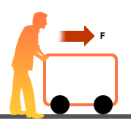
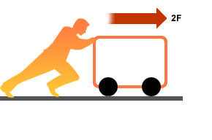
FACTORS AFFECTING ACCELERATION: Effect of Force
• Increase net force, keeping mass constant:
F
2F
2F
a
2a
m
m
F_{net} ↑ , a ↑
a α F_{net}
Acceleration is directly proportional to net force

Slide 6
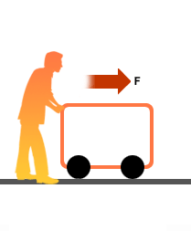
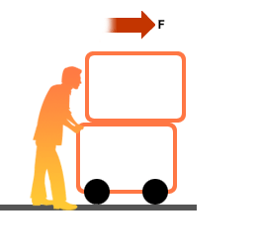

Effect of Mass:
• Increase mass, keeping net force constant:
a
m
a/2
m
m
m ↑ , a ↓
Acceleration is inversely proportional to mass

Slide 7
Ex. 1. A cart with mass 5.0 kg accelerates at 1.3 m/s ² [East].
What is the net force acting on the cart?
Ex. 2. A fridge is pushed so that it experiences a net force of
95 N [Forward] and accelerates at 0.74 m/s² [Forward].
What is the mass of the fridge?
Ex. 3. A 3.5 kg sled is pulled so that it experiences a net force
of 11 N [West]. What is the acceleration of the sled?
Answers: 1) 6.5 N [E] 2) 130 kg 3) 3.1 m/s² [W]

Slide 8
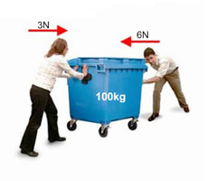


Sample Problem with more than one force: Two people push on a cart with forces of 65 N [ W] and 34 N [ E] as shown. If the cart has mass of 100.0 kg, what is its acceleration?
Step 1: Given and required:
F1=65 N[W]
F_{net} = ?
34 N [E]
F2=34 N[E]
a = ?
65 N [W]
m=100.0 kg
Step 2: Find net force
F_{net} = F1 + F2 [ W = +]
100.0 kg
= 65 – 34 = 31 N
= 31 N [W]
Step 3: Rearrange equation to solve for acceleration and substitute to solve.
∴ The cart accelerates at 0.31 m/s² [W].

